Slide 1

Sequence to sequence models
Bleu score
(optional)
deeplearning.ai

Slide 2
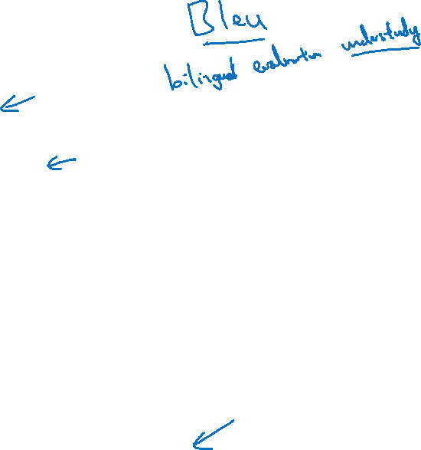
Evaluating machine translation
French: Le chat est sur le tapis.
Reference 1: The cat is on the mat.
Reference 2: There is a cat on the mat.
MT output: the the the the the the the.
Precision:
Modified precision:
[Papineni et. al., 2002. Bleu: A method for automatic evaluation of machine translation]

Slide 3
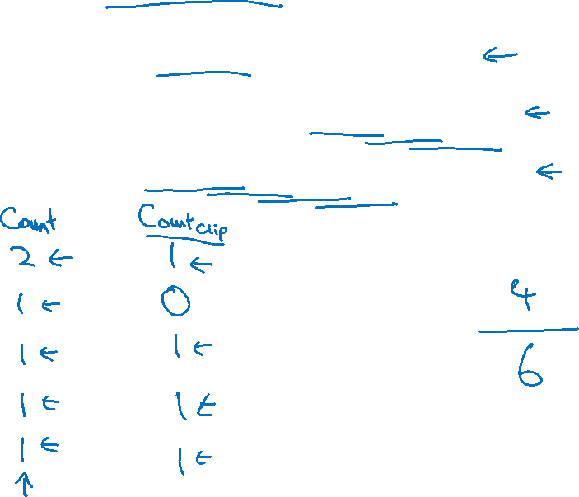
Bleu score on bigrams
Example:
Reference 1: The cat is on the mat.
Reference 2: There is a cat on the mat.
MT output: The cat the cat on the mat.
the cat
cat the
cat on
on the
the mat
[Papineni et. al., 2002. Bleu: A method for automatic evaluation of machine translation]

Slide 4

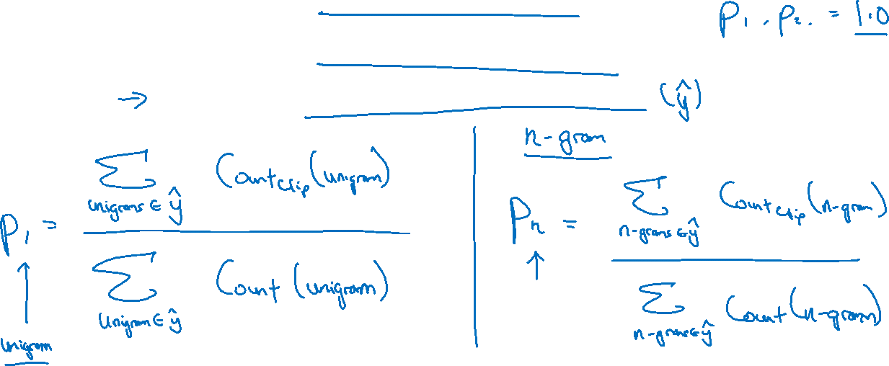

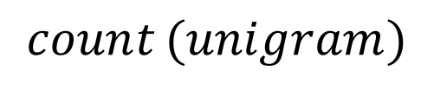
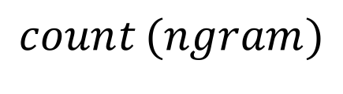


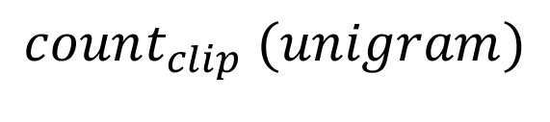
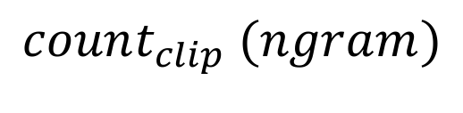
Bleu score on unigrams
Example:
Reference 1: The cat is on the mat.
Reference 2: There is a cat on the mat.
MT output: The cat the cat on the mat.
$$\sum_{unigram∈\hat{y}}^{ }{ }$$
$$\underset{ }{count_{clip}}{(unigram)}$$
$$\sum_{ngram∈\hat{y}}^{ }{ }$$
$$\underset{ }{count_{clip}}{(ngram)}$$
$$p_{1}= \frac{ }{ }$$
$$p_{n}= \frac{ }{ }$$
$$\sum_{unigram∈\hat{y}}^{ }{ }$$
$$\underset{ }{count_{ }}{(unigram)}$$
$$\sum_{ngram∈\hat{y}}^{ }{ }$$
$$\underset{ }{count_{ }}{(ngram)}$$
[Papineni et. al., 2002. Bleu: A method for automatic evaluation of machine translation]

Slide 5
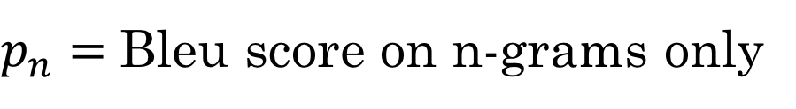
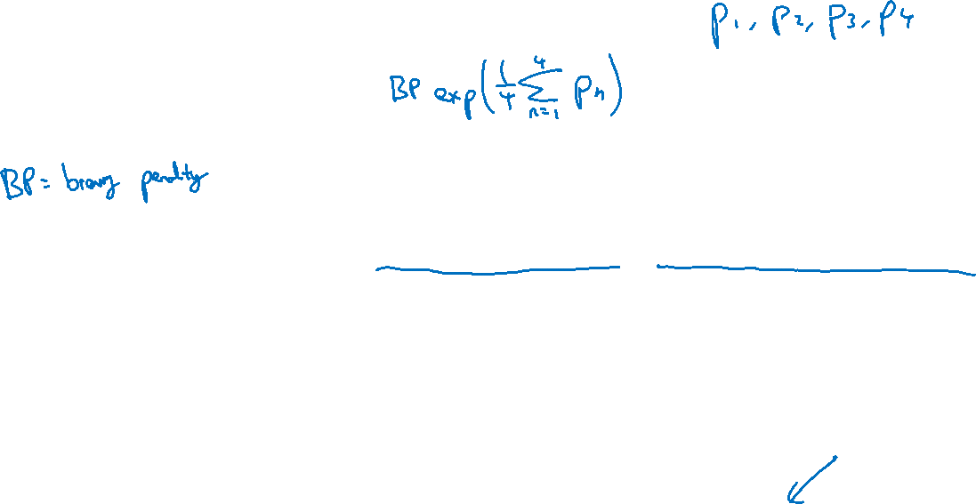
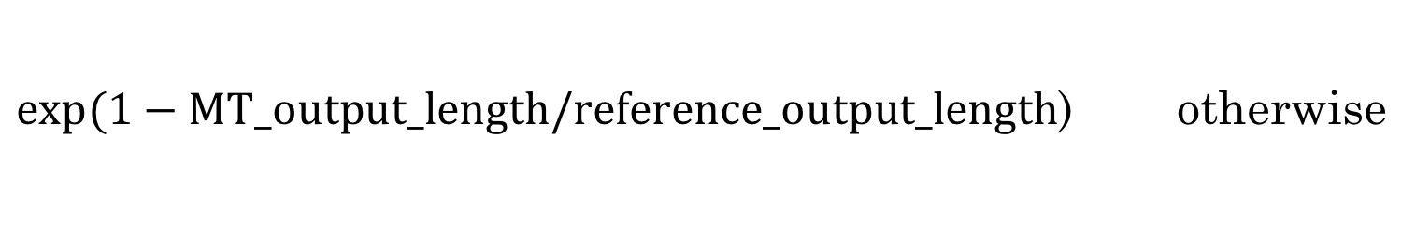
Bleu details
$p_{n}=$ Bleu score on n-grams only
Combined Bleu score:
$1$ if MT_output_length > reference_output_length
BP =
$exp⁡(1−MT_output_length/reference_output_length$) otherwise
[Papineni et. al., 2002. Bleu: A method for automatic evaluation of machine translation]

